Slide 1
Exploring Melting Hail Using One-Dimensional Hail Trajectory Modeling and Observations
Hannah C. Vagasky
Atmospheric and Environmental Research
Rebecca D. Adams-Selin, Sarah D. Bang, Andrew J. Heymsfield, Aaron Bansemer, Chase Calkins, Jeana Mascio
November 10, 2025
UW-Madison Colloquium
Madison, WI
Work funded by:
NSF grant AGS-2410913 (ICECHIP)
NASA grants 80NSSC22K0612 & 80NSSC22M0301

Slide 2
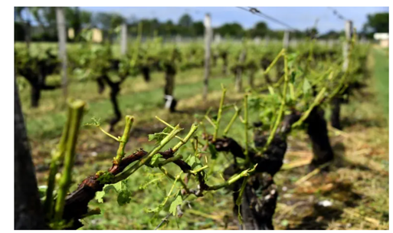
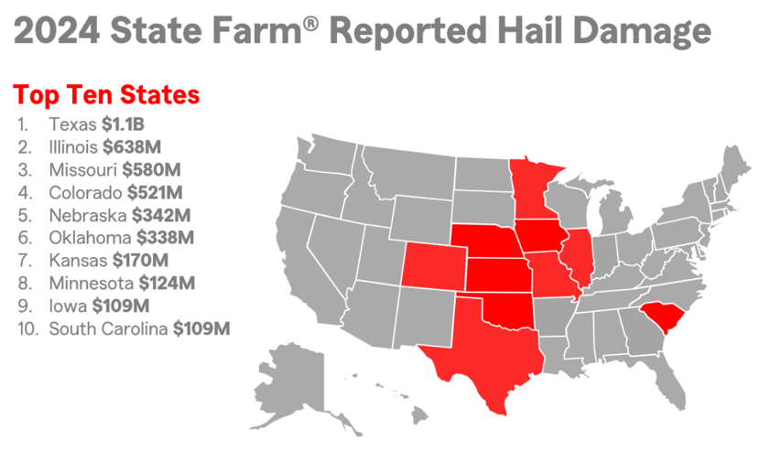
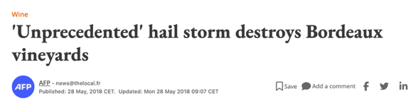
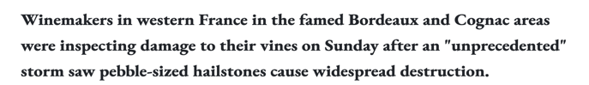

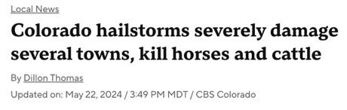
Hail is an Economic, Agricultural, and Safety Hazard
2024 Hail Insurance Statistics
Crop Susceptibility
https://www.thelocal.fr/20180528/unprecedented-hailstorm-hits-bordeaux-winegrowers-leaving-widespread-destruction
Safety
https://newsroom.statefarm.com/hail-damage-increases-in-2024-5-tips-to-reduce-it/
Wisconsin Climatology Office: $2 million of hail damage in 2024
Over 85% due to crop damage
https://www.cbsnews.com/colorado/news/colorado-hail-storms-damage-towns-kill-horses-cattle/
https://climatology.nelson.wisc.edu/highlighting-wisconsins-hail-history/#:~:text=Damage%20and%20Impact,miles%20per%20hour%20damaged%20homes.
https://bnn.network/breaking-news/climate-environment/87-injured-7-hospitalized-as-massive-hailstorm-hits-red-rocks-during-louis-tomlinson-concert/

Slide 3
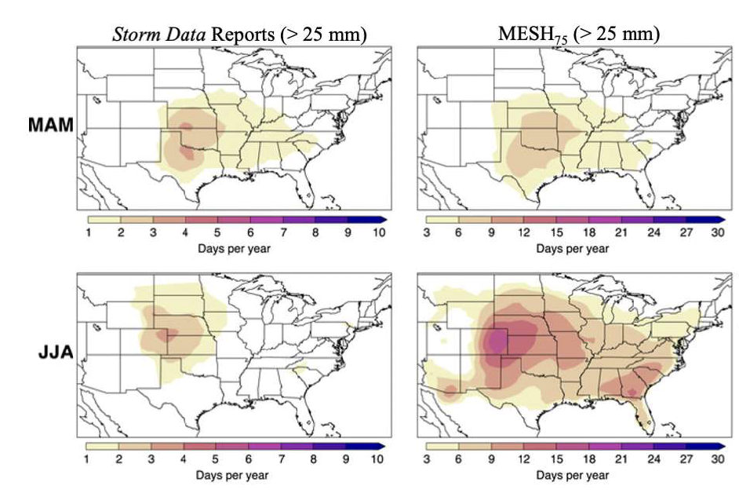
Why Should We Study Melting Hail?
Hail damage potential influenced by:
Velocity
Terminal velocity is a component
Size
Impacted by the degree of melting
Radars and satellites are capable of detecting hail aloft
Does not guarantee that the hail will reach the surface
Differences in surface and remote observations suggest hail sometimes melt substantially as it falls
Hail Distribution based on Observations and Radar Data
Number of hail days per year as determined by Storm Data (left column, > 25 mm hail), MESH75 radar-based algorithm (right column, > 25 mm hail). Top row is from spring (MAM) and bottom row from summer (JJA). (Murillo et al. 2021)

Slide 4
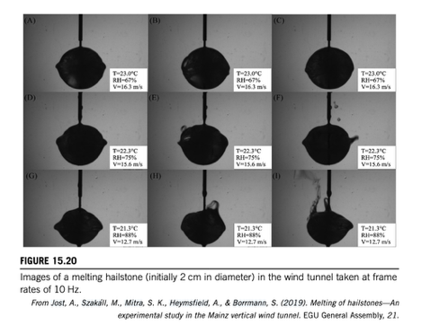
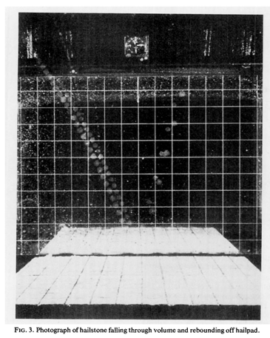

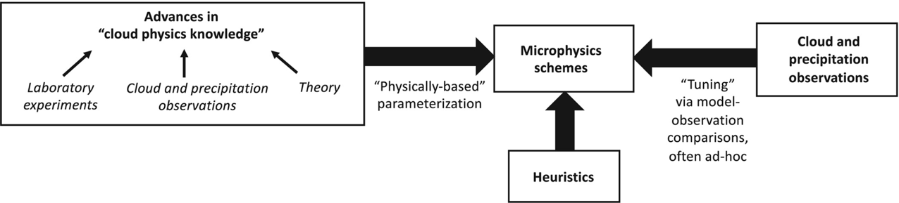
How do we study hail melt and hail terminal velocity?
Hail in a Wind Tunnel
Image of Hail Falling Through Roof of Van in Front of a Mirror
Methods
Wind tunnels
Observations
Field campaigns
Radar
Theoretical hailstone modeling
South Dakota School of Mines T – 28 Aircraft
Theis et al. 2022
https://archive.eol.ucar.edu/projects/t28/visualization/index.htm
Detwiler et al. 2012, Field et al. 2019, Heymsfield et al. 2023, Johnson and Smith 1980
Matson and Higgins 1980
One common outcome of these studies are new/modified parameterizations
Morrison et al. 2020
Relatively little work
Several studies since the 1960s

Slide 5
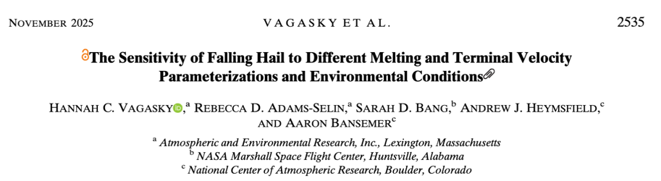



Presentation Outline
OBJECTIVE: Use observations and models to further our understanding of how hail melts and evaluate parameterizations
Hail Trajectory Modeling
Supercell HAILMELT Simulation
Parameterization sensitivity
Environmental sensitivity
Ongoing and Future Evaluation Work
GPM satellite and citizen science
ICECHIP field campaign
Conclusions
DOI: https://doi.org/10.1175/MWR-D-24-0180.1

Slide 6
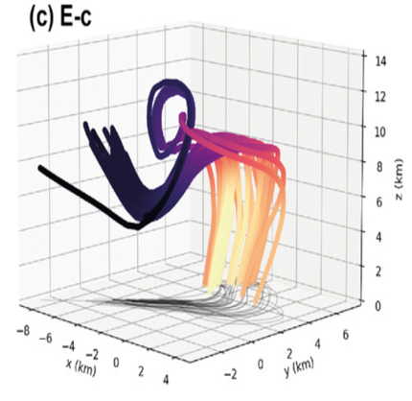
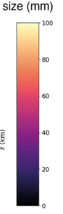
Hail Trajectory Model: Introduction to HAILMELT
Hail trajectory modeling:
Simulates the path a hailstone takes through a storm and the microphysical processes that act on it
Example: HAILCAST (Adams – Selin and Ziegler 2016, Adams – Selin 2023, Pounds et al. 2024)
HAILMELT: (Vagasky et al. 2025, https://github.com/hvagasky/HAILMELT_2024manuscript)
Simplified Python version of HAILCAST that
Only tracks falling hail
Only accounts for melting and terminal velocity
Includes droplet shedding (Mansell et al. 2020, Rasmussen et al. 1984)
No hail growth
Hail assumed spherical and the size distribution initialized a priori
Environmental conditions prescribed by a sounding
Modified above the LCL to be saturated, cool moist adiabatically.
Vertical velocity is prescribed, constant in time, and based on previous studies
Marwitz et al. 1973, Heymsfield et al. 2010, Giangrande et al. 2013, North et al. 2017
Multiple melting and terminal velocity parameterizations have been implemented
Hail Trajectory Simulated Through a Supercell
HAILMELT
Fisher et al. 2025

Slide 7
Hail Trajectory Model: HAILMELT Parameterizations
Hail Melt Parameterizations
All based on heat transfer equation from Macklin 1963
Differ in terms of hail characteristics reflected in empirically determined atmospheric and heat transfer constants
Rasmussen and Heymsfield 1987 [mRH1987]
Hail is smooth, spherical, & may be wet
No tumbling or roughness
Wang and Chueh 2020 [mWC2020]
Hail is dry, smooth, & spherical but contains lobes
No tumbling or roughness
Zhang and List 1994 [mZL1994]
Hail is dry, rotating, & non-spherical hail
No tumbling or roughness
Terminal Velocity Parameterizations
Rasmussen and Heymsfield 1987 [tRH1987_xre]
Hail is smooth, spherical
No tumbling
Calculated directly based on Best Number and Reynolds Number
Heymsfield et al 2018 [tH2018_vd]
Empirical relationship between maximum diameter/terminal velocity based on wind tunnel measurements of 3D-printed hailstones
Hailstones could be rough, have lobes, tumble, and/or non-spherical
Based on maximum diameter and pressure adjustment
Notes:
Reynolds Number = ratio of inertial to viscous force, sued to define type of flow regime, low = laminar, high = turbulent
Best Number = characterizes particle dynamics in fluids, Used with the Reynolds number to relate terminal velocity with the drag coefficient

Slide 8
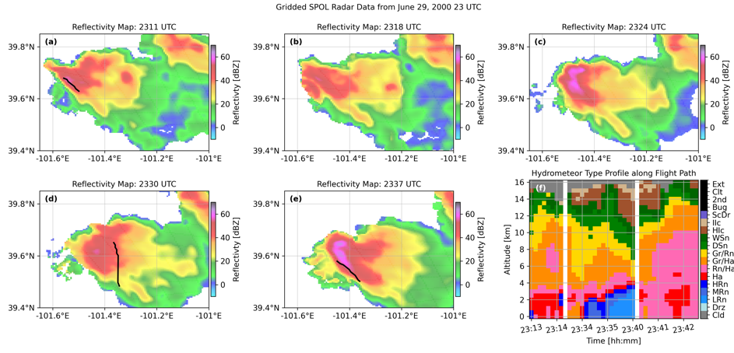
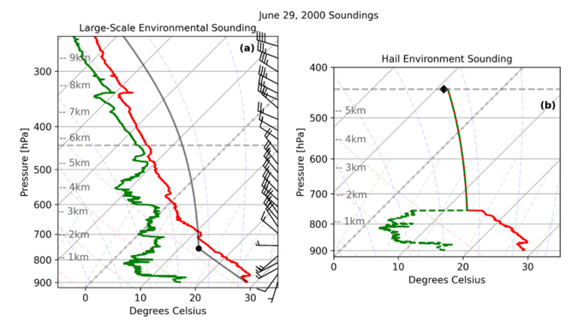
Supercell Simulation: Storm & Simulation Details
June 29th, 2000 in Kansas
Severe Thunderstorm Electrification and Precipitation Studies (STEPS) field campaign
“Golden case”
Tessendorf et al. 2005ab, Wiens et al. 2005, Kulham et al. 2006
Hail observed at surface (20 – 45 mm)
Armored plane from the South Dakota School of Mines flew through the storm between 0 – -12ºC
Detwiler et al. 2012, Field et al. 2019, Heymsfield et al. 2023, Johnson and Smith 1980
Obtain hail size distribution using a laser hail spectrometer prior to melting (0.5 – 50 mm)
Data provided by Andy Heymsfield and Aaron Bansemer
1 km Reflectivity and T—28 Flight Path
June 29, 2000
2311 UTC
2318 UTC
2324 UTC
2330 UTC
2337 UTC
Soundings
Mesonet Sounding
Modified HAILMELT Sounding
Additional HAILMELT details
Vertical velocity profile assumed to 5 m/s above the LCL and 0 m/s below the LCL
Storm environment based on mobile mesonet sounding

Slide 9
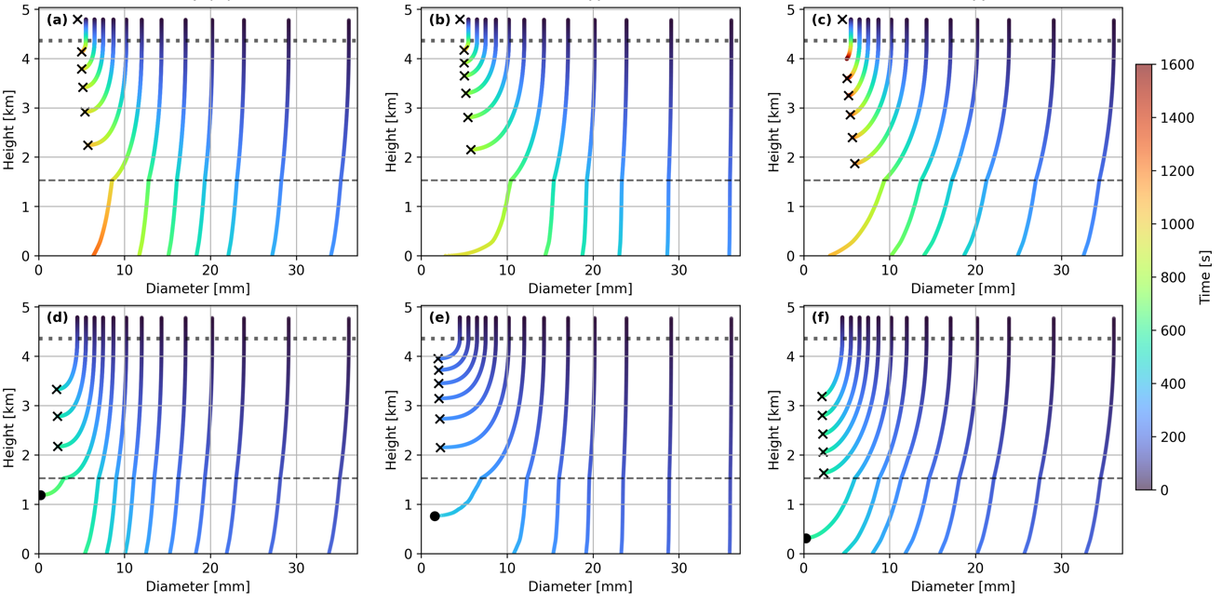
Supercell Simulation: Parameterization Sensitivity
Height – Diameter Evolution For Each Parameterization Combination
mWC2020
mZL1994
mRH1987
tH2018_vd
tRH1987_xre

Slide 10
Supercell Simulation: Parameterization Sensitivity
Height – Diameter Evolution For Each Parameterization Combination
mWC2020
mZL1994
mRH1987
tH2018_vd
tRH1987_xre

Slide 11
Supercell Simulation: Parameterization Sensitivity
Height – Diameter Evolution For Each Parameterization Combination
Melting
Smaller sizes:
mWC2020 – starts slow then increases
mZL1994 – fastest melt rate, especially at smallest sizes
mRH1987 – constant melt rate
Larger sizes:
mZL1994 – hardly melts
mRH1987 – most melting
mWC2020
mZL1994
mRH1987
tH2018_vd
tRH1987_xre

Slide 12
Supercell Simulation: Parameterization Sensitivity
Height – Diameter Evolution For Each Parameterization Combination
Melting
Smaller sizes:
mWC2020 – starts slow then increases
mZL1994 – fastest melt rate, especially at smallest sizes
mRH1987 – constant melt rate
Larger sizes:
mZL1994 – hardly melts
mRH1987 – most melting
mWC2020
mZL1994
mRH1987
tH2018_vd
tRH1987_xre
Terminal velocity
tH2018vd slower than tRH87xre
*** for these sizes ***

Slide 13
Supercell Simulation: Parameterization Sensitivity
Height – Diameter Evolution For Each Parameterization Combination
Melting
Smaller sizes:
mWC2020 – starts slow then increases
mZL1994 – fastest melt rate, especially at smallest sizes
mRH1987 – constant melt rate
Larger sizes:
mZL1994 – hardly melts
mRH1987 – most melting
mWC2020
mZL1994
mRH1987
tH2018_vd
tRH1987_xre
Terminal velocity
tH2018vd slower than tRH87xre
*** for these sizes ***
Behavior of falling hail is very sensitive to parameterization
Sensitivity is much stronger than expected

Slide 14
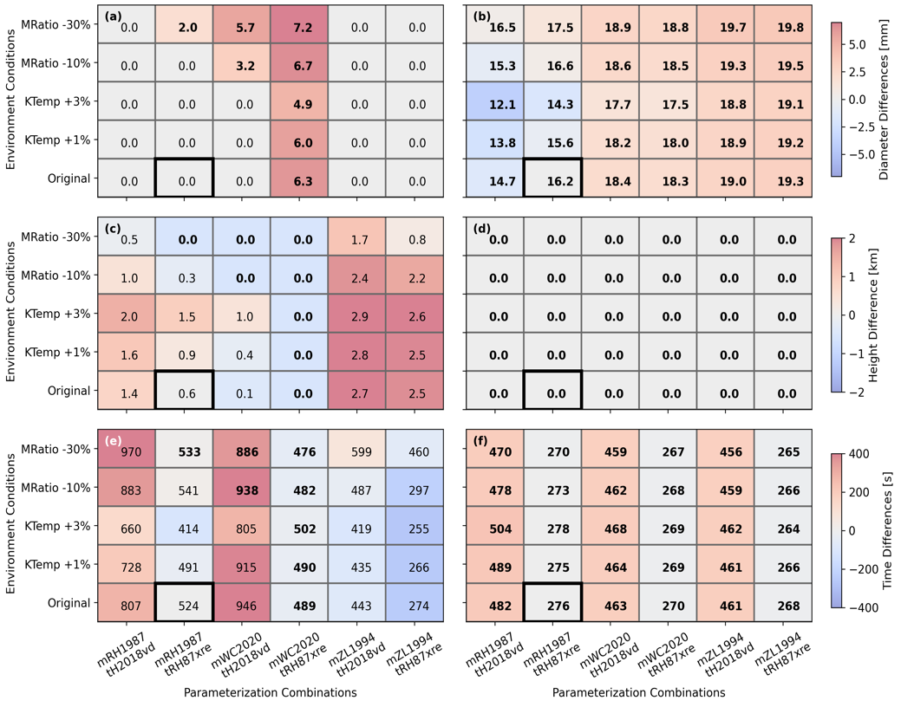
Supercell Simulation: Environmental Sensitivity
Variability of Final Hail Characteristics Across Parameterizations and Environments
8.7 mm hail
20.2 mm hail
Additional simulations that systematically increased temperature and decreased moisture
Magnitude of the perturbations consistent with climatology
Diameter Differences
Height Differences
Time Differences

Slide 15
Supercell Simulation: Environmental Sensitivity
Variability of Final Hail Characteristics Across Parameterizations and Environments
8.7 mm hail
20.2 mm hail
Additional simulations that systematically increased temperature and decreased moisture
Magnitude of the perturbations consistent with climatology
Diameter Differences
Bigger Hail (20.2 mm)
Reaches the surface in almost every simulation
Some variability in fall time
Diameter has greatest variability
Height Differences
Time Differences

Slide 16
Supercell Simulation: Environmental Sensitivity
Variability of Final Hail Characteristics Across Parameterizations and Environments
8.7 mm hail
20.2 mm hail
Additional simulations that systematically increased temperature and decreased moisture
Magnitude of the perturbations consistent with climatology
Diameter Differences
Bigger Hail (20.2 mm)
Reaches the surface in almost every simulation
Some variability in fall time
Diameter has greatest variability
Smaller Hail (8.7 mm)
Variability across all characteristics
Time/duration has the greatest variability
Height Differences
Time Differences

Slide 17
Supercell Simulation: Environmental Sensitivity
Variability of Final Hail Characteristics Across Parameterizations and Environments
8.7 mm hail
20.2 mm hail
Additional simulations that systematically increased temperature and decreased moisture
Magnitude of the perturbations consistent with climatology
Diameter Differences
Bigger Hail (20.2 mm)
Reaches the surface in almost every simulation
Some variability in fall time
Diameter has greatest variability
Smaller Hail (8.7 mm)
Variability across all characteristics
Time/duration has the greatest variability
Height Differences
Time Differences
Parameterization variability is often as large (and sometimes larger) than environmental variability
Variability not limited to diameter

Slide 18
Supercell Simulation Conclusions & Implications
Developed a simplified hail trajectory model called HAILMELT
Python-based and only considers falling, melting hail
Environment, vertical velocity, and initial hail size set a priori
https://github.com/hvagasky/HAILMELT_2024manuscript
Simulated hail is substantially impacted by which hail melt and terminal velocity parameterizations are used
Including hail diameter, height, and fall time
Parameterization variability is often as large (and sometimes larger) than environmental variability
Differences in the predicted diameter, height, and fall duration are important since:
Impacts when, where, and how much damage occurs
Can impact storm dynamics and evolution
Which parameterization is most
realistic?

Slide 19
Presentation
OBJECTIVE: Use observations and models to further our understanding of how hail melts
Hail Trajectory Modeling
Supercell HAILMELT Simulation
Parameterization sensitivity
Environmental sensitivity
Ongoing and Future Evaluation Work
GPM satellite and citizen science
ICECHIP field campaign
Conclusions
DOI: https://doi.org/10.1175/MWR-D-24-0180.1

Slide 20
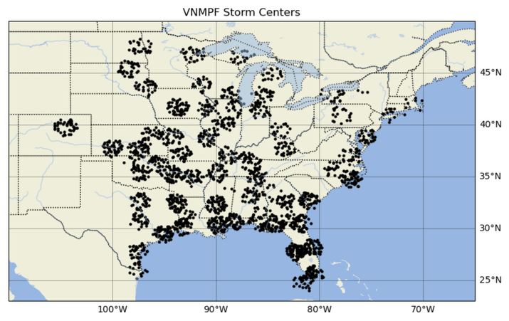
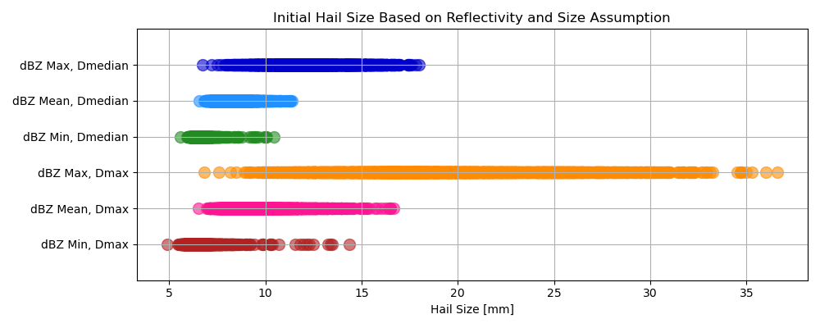
Current Validation: GPM Satellite
NASA’s Ground Validation System Validation Network - Multiplatform Precipitation Feature (VN-MPF) Database
Bang et al. 2023
Identifies storms that were simultaneously detected by the GPM satellite and a NEXRAD radar
Contains over 2,000 storms from 2014 – 2023 across the United States
The dual-frequency radar on GPM:
Includes a “hail flag”
Reflectivity from the -20°C level can be used to estimate in-cloud hail size (Heymsfield et al. 2023)
Location of VN-MPF Storms (2014 – 2023)
Distribution of Initial Hail Size Based on GPM Ku-band reflectivity at -20 °C

Slide 21
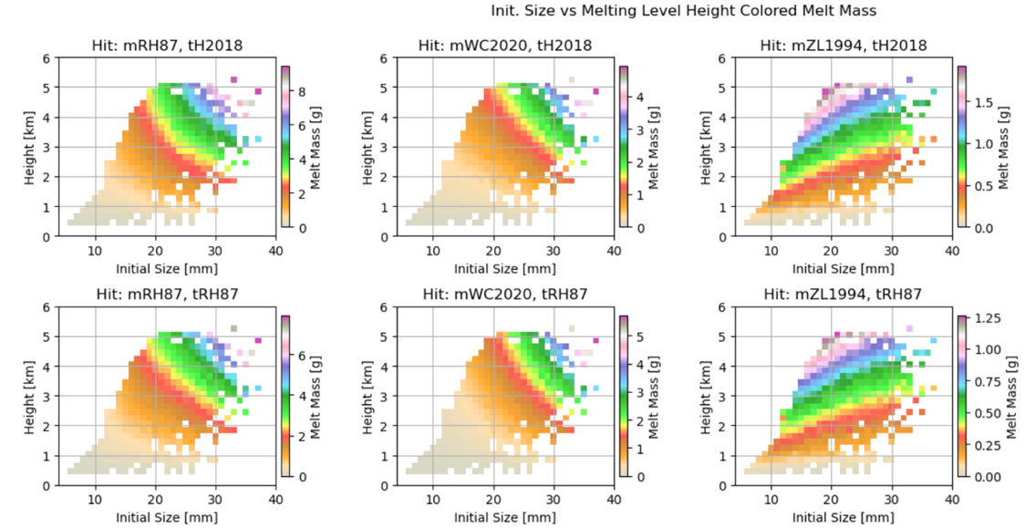
HAILMELT Simulations of the Full VN-MPF Dataset
Repeated HAILMELT simulations for each VN-MPF case
Environmental conditions based on RAP analysis profile near the location of each storm
Assumed no vertical velocity
Hail size is initialized based on an empirical relationship with the DPR reflectivity
Large sample size of VN-MPF allows for statistical analyses and identification of systematic differences
Mass of Ice Melted based on Initial Size and Melting Level Height
mRH1987
mWC2020
mZL1994
Investigated how much melting occurred based on the initial hail size and the environmental melting level
The ZL1994 melting parameterization behaves distinctly different
tH2018_vd
Melting Level Height [km]
tRH1987_xre
Initial Size [mm]

Slide 22
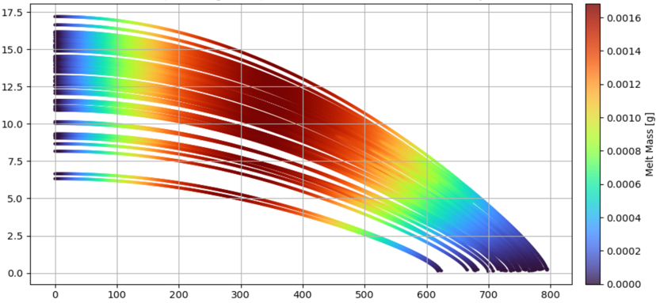
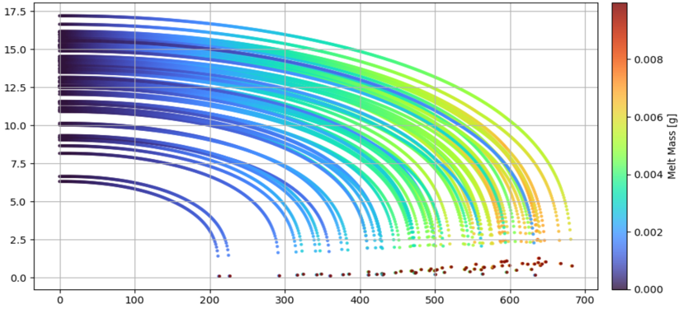
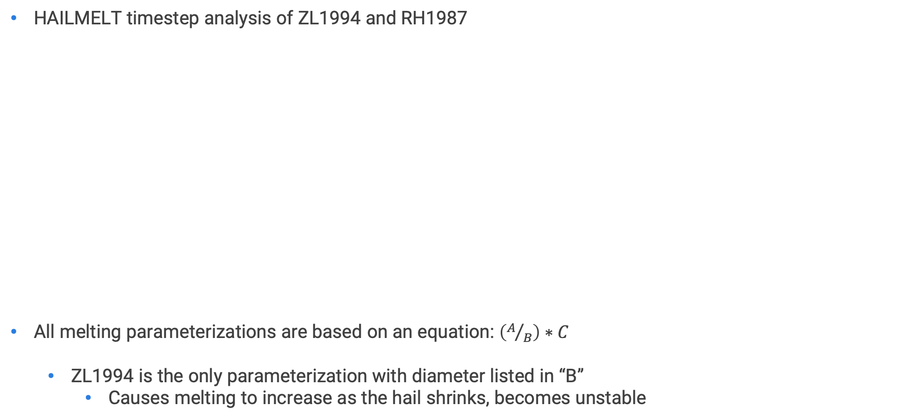
HAILMELT Simulations of the Full VN-MPF Dataset
HAILMELT timestep analysis of ZL1994 and RH1987
All melting parameterizations are based on an equation: $\left(A/B\right)∗C$
ZL1994 is the only parameterization with diameter listed in “B”
Causes melting to increase as the hail shrinks, becomes unstable
Time Series of Diameter and Ice Melt
mRH1987 & tH2018vd
mZL1994 & tH2018vd
Diameter [mm]
Melt Mass [g]
Melt Mass [g]
Time Step [s]
We no longer consider ZL1994 a viable melting parameterization

Slide 23
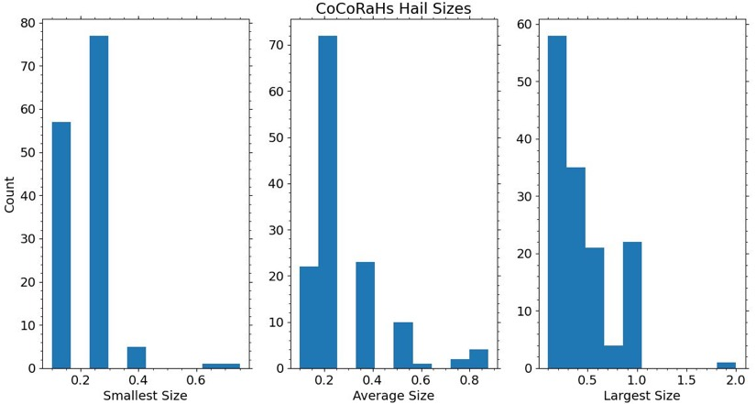
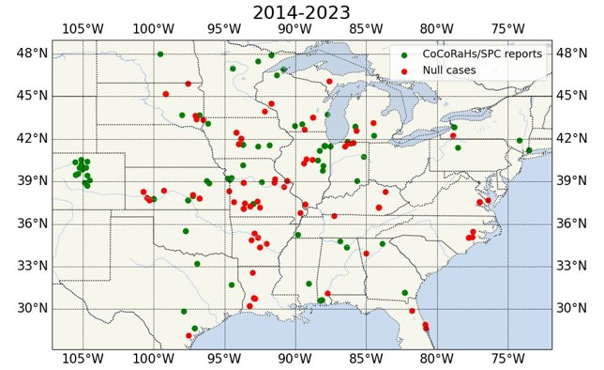
Current Evaluation: GPM Satellite and Citizen Science
The Community Collaborative Rain, Hail, & Snow Network (CoCoRaHS)
National non-profit, community of volunteer citizens that record precipitation (including hail)
Using CoCoRaHS data to identify storms within the VN-MPF database that have confirmed hail on the ground
Require that a storm be associated with CoCoRAHs report that
Includes an estimate of the smallest and largest hail sizes
Reported within 1 hour
Occurred within 100 km of the center of the storm
~ 60 storms are confirmed
CoCoRaHS Hail Size Distribution
Confirmed Hail VN – MPF Cases in Green (2014– 2023)
Smallest Size
Average Size
Largest Size

Slide 24
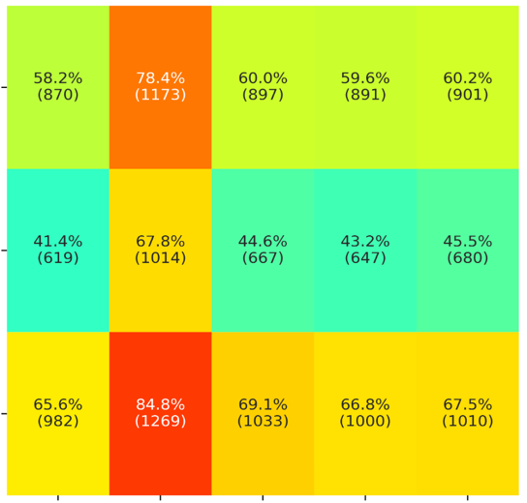
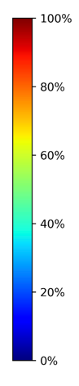
Preliminary HAILMELT Simulations of CoCoRAHs Cases
HAILMELT Simulations
Environmental conditions based on ERA5
Ensemble of vertical velocities (-3 to 3 m/s)
Hail size is initialized based on DPR reflectivity
Additional melting and terminal velocity parameterizations included
A simulation is validated if hail reaches the surface within the smallest to largest size range provided by CoCoRAHS
Percentage of Simulations that Verify
Results
Melting
WC2020 degraded performance
RH1987 & G1969 similar
Terminal velocity
H2018vd stands out above
Only parameterization based on an empirically derived maximum diameter – terminal velocity parameterization
All other parameterizations perform similarly
All based on Reynolds’ and Best Number relationships
mRH1987
mWC2020
Melting Parameterizations
mG1969
tB1989_xre
tH2018_vd
tH2018_xre
tHW2014_xre
tRH1987_xre
Terminal Velocity Parameterizations
This project is ongoing. CoCoRAHs is working to increase citizen participation, especially in the southeast United States.

Slide 25

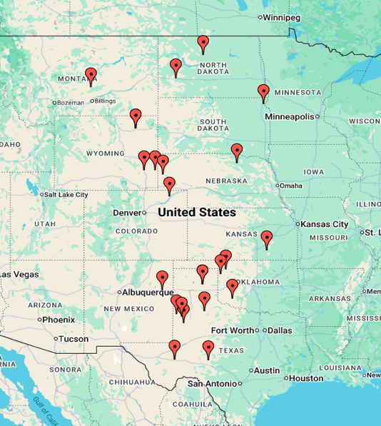

Future Evaluation: ICECHIP Field Campaign
In-situ Collaborative Experiment For The Collection Of Hail In The Plains
May – June 2025
46 days gone (5 rest days)
24 IOPs (18 with hail!)
15,000 miles of driving
7,000 hailstones measured or crushed in field
18 boxes of hail preserved in NCAR cold lab

Slide 26
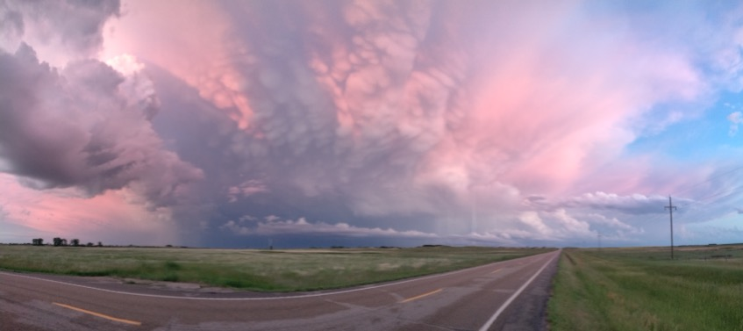
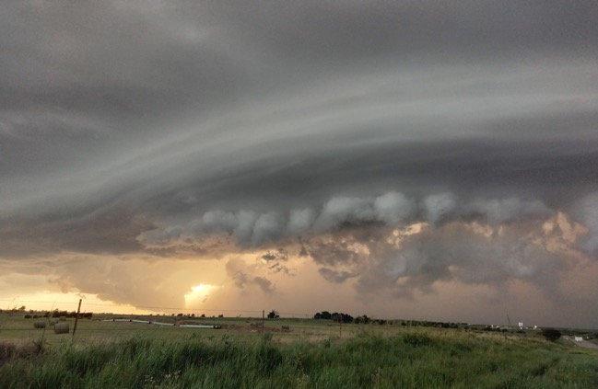
ICECHIP Field Campaign: Science Themes
Gain better understanding of hailstone development, in storm characteristics, and fall behavior.
Examine in-storm hail trajectory and convective updraft relationships.
Assess the impact of differing environmental thermodynamic and kinetic regimes and geographic location on hail processes and predictability.
Summarize surface properties of hailstones and associated impacts.
Characterize hailstone physical properties at the surface and their relationship to radar observations

Slide 27
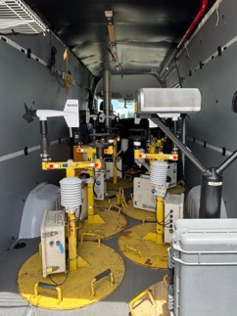
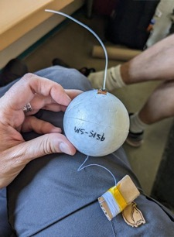
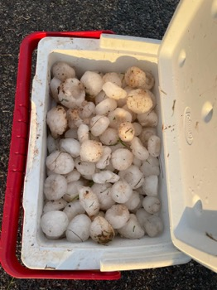
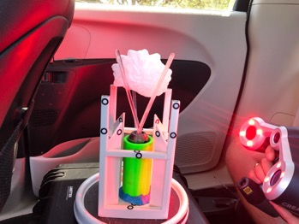
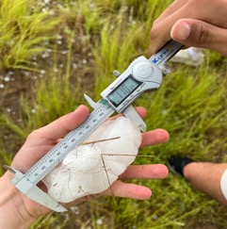
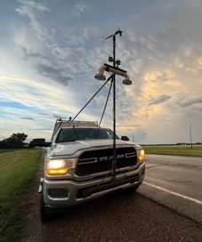

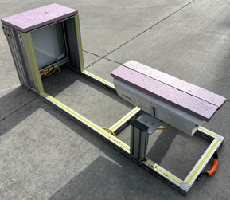
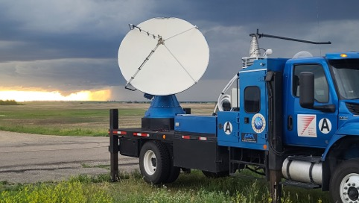
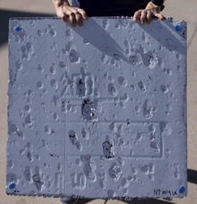
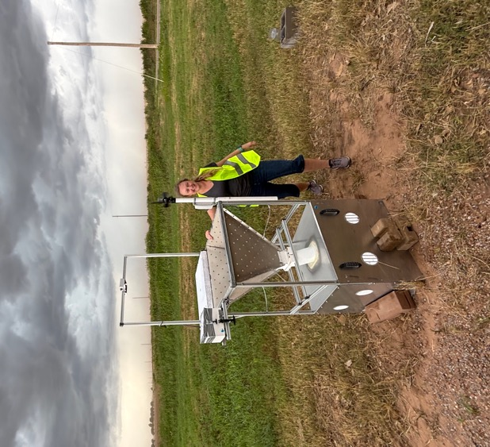
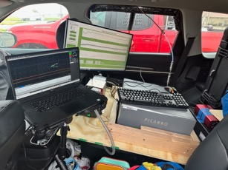

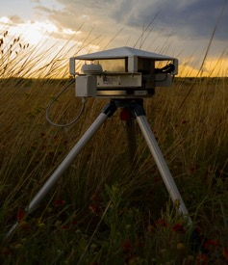
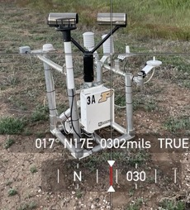
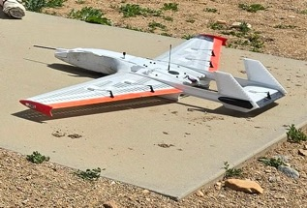
ICECHIP Field Campaign: Field Measurements
Pre-, near-, and post-storm environmental observations
4 mobile radars
Isotopic characterization of inflow
Hailstone embryo released into inflow to directly characterize evolution
SuMHO
Hail swath measurements
Hail pads, disdrometers, impact disdrometers
Hail collection – measured, 3-D scanned, crushed, preserved in cold lab
Post – event UAS hail swath scanning
Pre-, near-, and post-storm environmental observations
Hail embryo probe
Hail collection, measurement, 3D scanning, & crushing
Hail pads
High-res camera + light
C- & X- band mobile radars
Vertically pointing radar, T/Td
Hailpad
Anemometer
High Speed Video Systems
Disdrometers
Rubber funnel
Battery-powered freezer
Isotopic characterization of inflow
UAS hail swath measurements
Super Mobile Hail Observatory

Slide 28
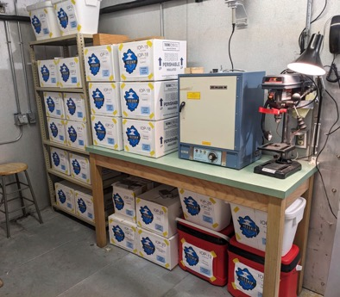
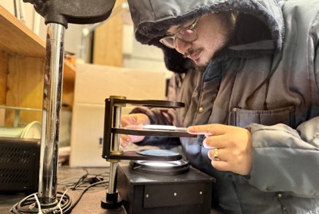
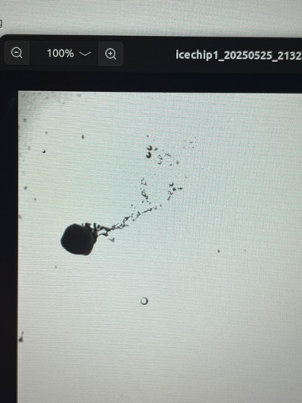
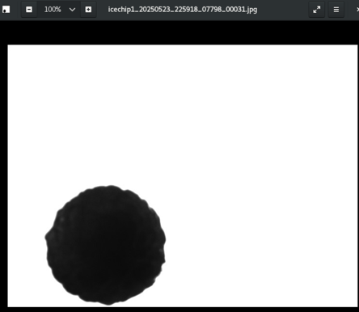
Future Evaluation: ICECHIP Field Campaign
Future Hail Melt Research
HAILMELT simulations
Unique validation opportunities
Comprehensive documentation of surface hail size distribution
Terminal velocity observations
High-speed cameras and vertically pointing radar
Model physics updates
Non-spherical hail
Droplet shedding
New ICECHIP-based parameterizations
Radar emulator
Anthony processing hail
Hail stored in NCAR cold lab
ICECHIP Operations are done but the science is just starting.
Stay Tuned.
https://icechip.niu.edu/, https://data.eol.ucar.edu/dataset/list?project=651&children=project
High–speed video images
Hail shedding drops
3-inch hailstone
Falling ~ 60 m/s

Slide 29
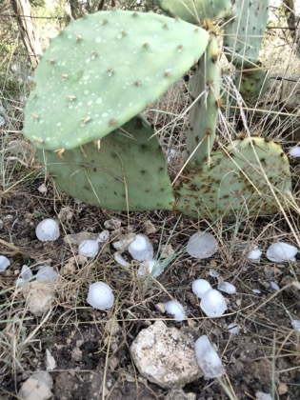
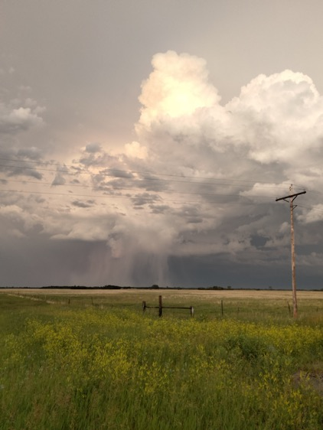
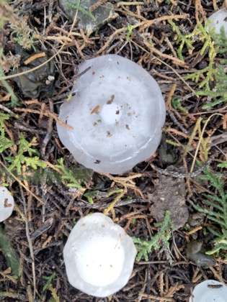
Summary & Conclusions
Hail melt and terminal velocity are important processes that impact the damage potential of hail
Several hail terminal velocity and hail melt parameterizations have been developed since the 1960s
Relatively little work has been done to comprehensively compare/evaluate
Developed a Python-based simplified hail trajectory model focused on falling, melting hail
Found large parameterization sensitivity
Currently working to determine which parameterizations are most accurate
Using CoCoRaHS observations to help validate final size
ICECHIP data will be used to validate hail size and terminal velocity
Thank You!

